Slide 1
Health Monitoring Application
UC Berkeley Extension Data Analytics BootCamp
Project 2
Alina Smirnova, Anna Burlyaeva, Himani Singh, Lucila Rondissone

Slide 2

Idea
Creating a tool to log, monitor and visualize various indicators about specific health conditions

Slide 3
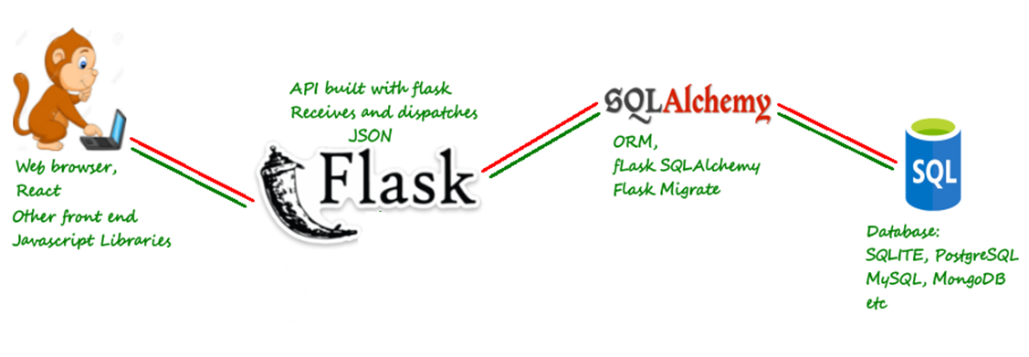
Architecture
Part 3: Fetch data from API
Part 1: Save info to MySQL DB
Part 2: Deployment
Flask + DB
Part 4: React.js + Material-UI

Slide 4

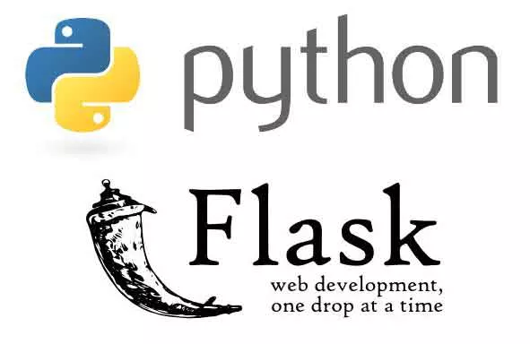

Back-end: MySQL + SQLAlchemy + Flask

Slide 5

Front-end: React.js + MaterialUI

Slide 6

Conclusion
Team work is a real pain, but it’s worth it ☺

Slide 7
Q&A
Thank you for your attention, we are ready to answer your questions

